Slide 1
A Tale of Two Clouds
Running an Application Across AWS and Azure
@_caseywatson

Slide 2
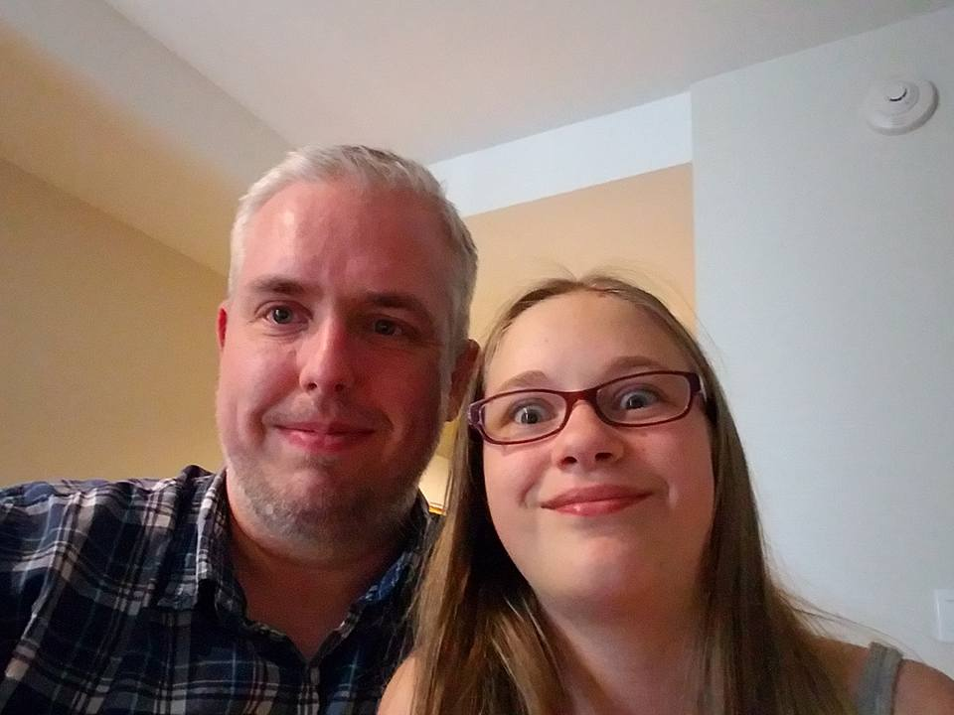

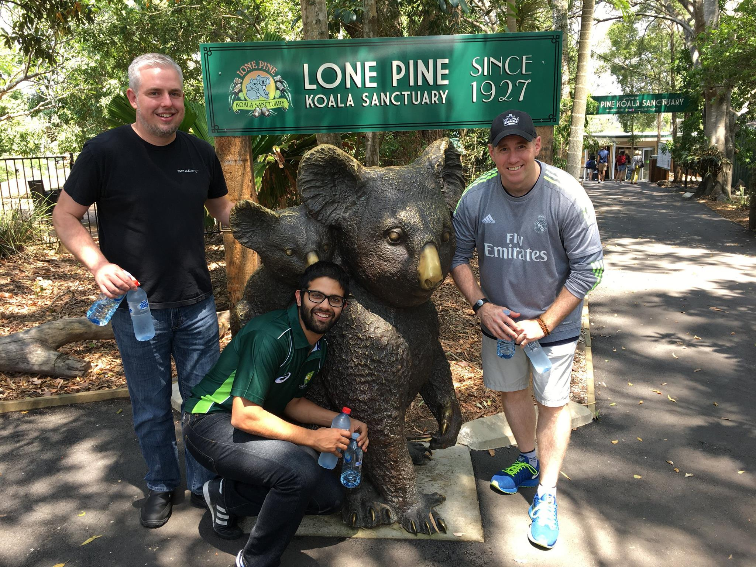
Hi! I’m Casey.
I live in Fort Worth, TX with my beautiful wife, daughter, three cats and one giant dog.
15 years of software development experience
Currently Senior Program Manager with the Azure Customer Advisory Team (AzureCAT) at Microsoft
I travel. A lot.
Avid enjoyer of whiskey

Slide 3
What is cloud portability?

Slide 4
Why design for cloud portability?
Improved High Availability/Disaster Recovery (HA/DR)
Cloud consumers want to know that they have options
Promotes testability and cleaner architecture
Future-proofing
Compliance and regulations

Slide 5
Introducing the Multi-Cloud File Sharing App

Slide 6
Multi-Cloud File Sharing App Requirements
Web application that lets users anonymously upload, browse, and download files
Geo-distributed deployment
Multiple cloud platforms
Native PaaS
Shared code base (where possible)
Minimal cost
Curveball: .NET + NodeJS!

Slide 7
Multi-Cloud File Sharing App Design Considerations
Eventual consistency, strong consistency, or both?
How do we scale to handle unexpected spikes in traffic?
How do we ensure that users have the smoothest possible experience regardless of where they are located?
How do we store the files?
How do we store photo metadata? Relational database? NoSQL?
How can we use .NET and NodeJS together?
How can we maximize code reuse and minimize waste?
How do we control costs?

Slide 8
Notional Application Architecture
Web UI
Replication Relay
Get File Metadata API
Update File Metadata API
Outbound File Replication Topic
Replication Relay
File Store
File Metadata Store
File Replication Processor
Inbound File Replication Queue
Replicate File API
“Other Cloud”

Slide 9




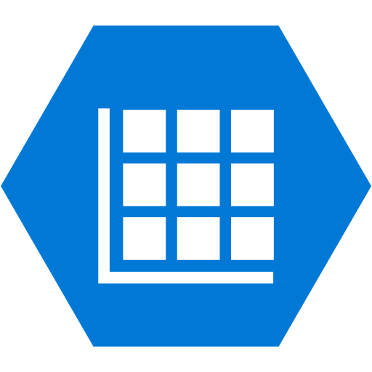


Azure Application Architecture
Web App
Replication Relay Function
Get File Metadata API Function
Update File Metadata API Function
Outbound File Replication Service Bus Topic
Replication Relay Function
File Blob Storage Container
File Metadata Storage Table
File Replication Processor Function
Inbound File Replication Service Bus Queue
Replicate File API Function
AWS

Slide 10






AWS Application Architecture
Elastic Beanstalk Web App
Replication Relay Function
Get File Metadata API Function
Update File Metadata API Function
Outbound File Replication SNS Topic
Replication Relay Function
File S3 Bucket
File Metadata DynamoDB Table
File Replication Processor Function
Inbound File Replication SNS Topic
Replicate File API Function
Azure

Slide 11
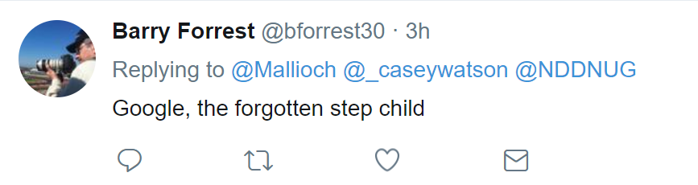

Slide 12







Global Application Architecture
Azure Traffic Manager
(Weighted Profile)
multicloudfilesharing.trafficmanager.net

Slide 13
Let’s take a look!

Slide 14
Try it out!
Go to mcafilesharing.trafficmanager.net and upload a file.

Slide 15
Key learnings
If DevOps is not part of your microservices story, you’re flying blind.
Cloud platforms are just different enough to make creating an abstraction layer difficult. Abstract features, not services.
Node.js isn’t as scary as I thought it would be.
I really like Node modules/NPM.
As a developer, I find Azure Functions easier to work with than AWS Lambda.

Slide 16
github.com/caseywatson/multicloudfilesharing
Find this deck and source code from tonight’s presentation online at

Slide 17
Thank you!
@_caseywatson

